Slide 1
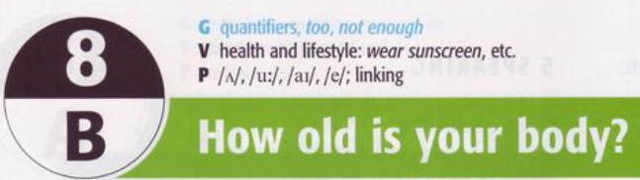

Slide 2
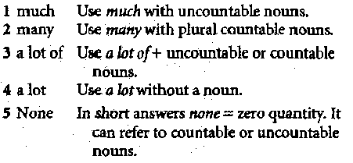
Grammar: Quantifiers

Slide 3
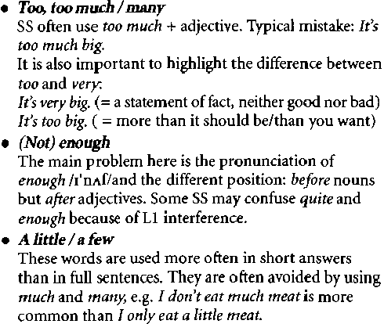



Slide 4


Slide 5


Slide 6
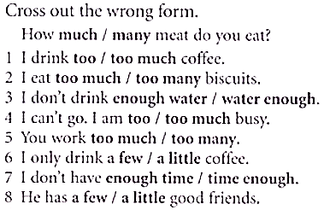
1 too | 5 too many
2 too much | 6 a few
3 water enough | 7 time enough
4 too much | 8 a little

Slide 7
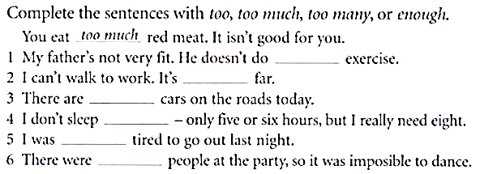
1 enough | 4 enough
2 too | 5 too
3 too many | 6 too many

Slide 8
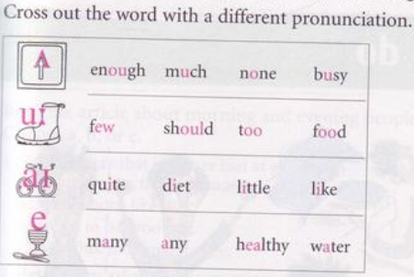

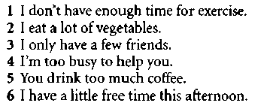

Pronunciation: : / ʌ /, /u:/, /ai/, and /e/, linking

Slide 9
21. The police.................the man where he was the day before?
told said asked
22. She said she phoned me the ................day.
previous before last
23. He told me he was going to leave for Singafore................month.
the following next previous
24. Are you surprised.................my attendent?
at on with
25. He apolozised ...............coming home late last night.
for at on
26. Do you dream.................studying oversea in the future?
of on about
27. What happened..............you last night?
to with at
28. When I came home yesterday, It ...................raining but the ground was still wet.
had stopped stopped stoped
29. To protect the environment, people shouldn’t..................rubbish away everywhere.
throw take go
30. I’m not going to work tomorrow so don’t..................me up early.
wake get pick

Slide 10
31. Candidates have to ....................the application form.
fill in look in call in
32. How...................is it from The UK tho The US?
far long much
33. There is only...................rice so it isn’t enough for me all day today.
A little a few a lot
34. Is there..........................new for us today, Madam?
anything much many
35. I can do.....................you want, my dear!
anything anyone anywhere
36. Peter..................that he loved Susan.
told said asked
37. My boss..................me that I deserved a promotion.
told said asked
37. Our teacher was so angry because we..........................do our homework.
hadn’t done have done did
38. I couldn’t get into my house because I..........................my key somewhere.
had lost losed have lost
39. I couldn’t say a word to Joe because When I came to the airport, his plane...........off.
had taken took have taken
40. They arrived at the cinema after the film.................
had started started starts

